Slide 1
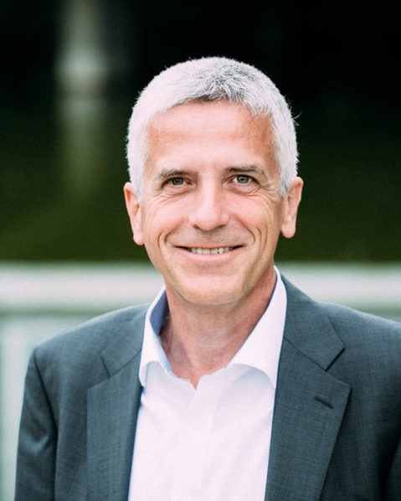
Impulse
LEADERSHIP IN A DIGITAL WORLD
shared – interconnected – empathic
6. November 2017
Matthias Mölleney
Head of the Center for HRM & Leadership HWZ University for Applied Sciences in Business Administration Zurich
Contact:
peopleXpert gmbh
Seestrasse 110a
8610 Uster (CH)
Phone: +41 44 940 6323
Email: matthias@moelleney.com http://www.peoplexpert.ch

Slide 2
Challenges of the next 5-10 years
Knowledge Management
Generation Management
Demographic Development
Migration Challenge
Technology
Fluid Organzation
4 Generations
International Competition
Values
Lack of Personnel
Project Organizations
Disappearing Hierarchies
Leadership
International Competition
Permanent Cost Pressure
Digitalization
Virtualization
Work-Life-Balance
Meaningful Work

Slide 3
I hate reality but it's still the best place to get a good steak…
Woody Allen

Slide 4
Technology Trends
3D-Print creates new opportunities in production, retail and logistics.
3D
Nano
Nanotechnology brings new materials
Industry 4.0
Robo
AI
Robotics provide human-like helpers.
Artificial Intelligence allows software to solve problems autonomously.
Notes:
4

Slide 5
Factors of digital transformation
Wear-ables
Drones
Big Data
Data
Self-Driving Cars
Robots
Internet of Things
Data-Based Routing
Digital Trans-formation
Auto-mation
Rapid Proto-typing
Smart Factory
Wear-able Compu-ting
E-Comm-erce
Remote Main-tenance
Apps
Cloud Compu-ting
Social Media
Digital Products
Info- tainment

Slide 6
New Jobs
Marketing
Human Resources
Sales
Chief Data Officer
Data Researcher
Traffic Manager
Employer Brand Director
Design Learning Manager
Digital Work Experience Expert
E-Business Manager
Digital Account Manager
Digital Product Manager
Digital Jobs
Web
Support Functions
Digital Marketing Professional
Digital Communications Mgr.
Digital Copywriter
Web Project Manager
Web Designer
SEO Manager
Content Manager
Chief Listening Officer
Social Media Manager

Slide 7
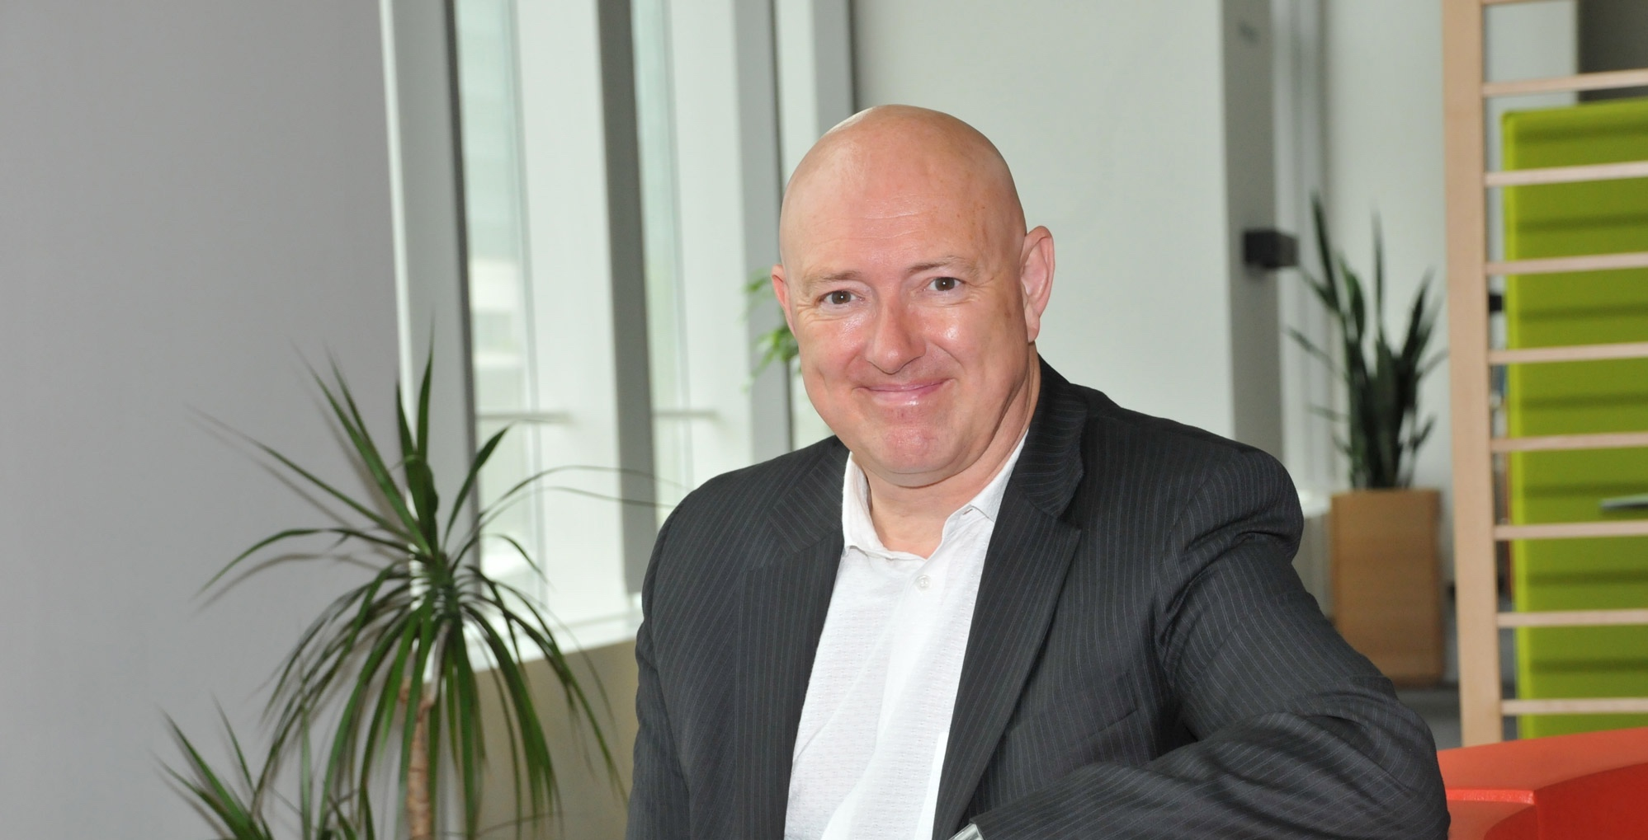
At Frank van Massenhove‘s organization, all employees can work when, how and where they want to work.

Slide 8
Agile methods in Change Management
Tool Box
Own working style
Discover the world
Participation
Change in the VUCA-world
Examples
Business Canvas, Barcamp
Trello, Taskulu
Learning Journey
Duale Operationg System (Kotter)
Lean Startup Thinking
Agile Organisational Development
Meeting Efficiency
CustomerInvolve-ment
Agile Project Manage-ment
Support for Experi-ments
Support for Labs
«a bit» Agility
No Hierarchy
Examples
Time Boxing
Design Thinking
Scrum, Kanban
Blue Islands
(virtual) Spin-offs
Democratic Leadership
Holacracy
Darstellung in Anlehnung an Dr. Katja Manski

Slide 9
Digital maturity
TRANSFORMED
INTEGRATED
DEFINED
CONCEPTUAL
No MATURITY
Digital change has been discussed in some areas, but there is still no implementation strategy.
Digital transformation has already been carried out with certain projects, but no cross-departmental corporate strategy can be defined.
Strategies are developed from pilot project experiences. A basic awareness of digital change develops within the company.
Digital media is integrated more deeply into business models where strategies have been developed and implemented. Core processes, products and services are digitized.
New approaches are emerging through the digitization of core processes, products and services. New control models are required. Corporate culture has undergone a lasting change.

Slide 10
Leadership in a digital world must be based on trust
early 80’s and before
late 80’s – early 90’s
mid 90’s – early 2000’s
Today and tomorrow
Leadership Concept
Command and Control
Management by Objectives (MbO)
MbO, Empowerment and Controlling
MbO, Inspiration and Collaboration
Leadership Goals
Leading top-down
Effectivity
Efficiency
Speed
Prerequisites
Authority
Hierarchy
Collaboration
Trust

Slide 11
The problem

Slide 12
The Prisoners‘ Dilemma as a Paradigm for Collaboration
Person B
cooperates
dominates
cooperates
3 / 3
1 / 4
4: all goals achieved
3: compromise
2: lowest common denominator
1: goals not achieved
Person A
dominates
4 / 1
2 / 2
Source: Prof. Dr. Julian Nida-Rümelin: «What we could learn from the Prisoners‘ dilemma», ZEIT-Akademie 2012

Slide 13
Multiple Identities and the Quality of Leadership
Misalignment and alignment in strategies used to manage a subordinate’s multiple identities
Resource utilization in the relationship
Quality of the manager- subordinate relationship
Strategy misalignment
M: Exclusionary strategy
S: Inclusionary strategy
Resource suppression
Low quality
Perception of unequal resource contribution
Decreased psychological safety
Lack of mutual growth-in-connection
M: Inclusionary strategy
S: Exclusionary strategy
Resource exploitation
Social exchange
Perception of equal resource contribution
Increased psychological safety
Lack of mutual growth-in-connection
Strategy alignment
M: Exclusionary strategy
S: Exclusionary strategy
Resource exchange
Generative
Perception of equal resource contribution
Increased psychological safety
Mutual growth-in-connection
M: Inclusionary strategy
S: Inclusionary strategy
Resource production
Source: Creary, Caza and Roberts, «Out of the box? How managing a subordinate’s multiple identities affects the quality of a manager-subordinate relationship», Academy of Management Review 2015, Vol. 40, No. 4, 538–562.

Slide 14
Project Aristotle
# 1 reason why team perform better than others: psychological safety

Slide 15
New rules for the future of work
«Why would I ask somebody with a job title, if I could ask someone who knows the answer?»
Source: Future Work Forum Research: Employing the Next Generation

Slide 16
We must get acquainted with loosing control
If you think you have everything under control you are too slow.
Mario Andretti, US Racing Driver

Slide 17
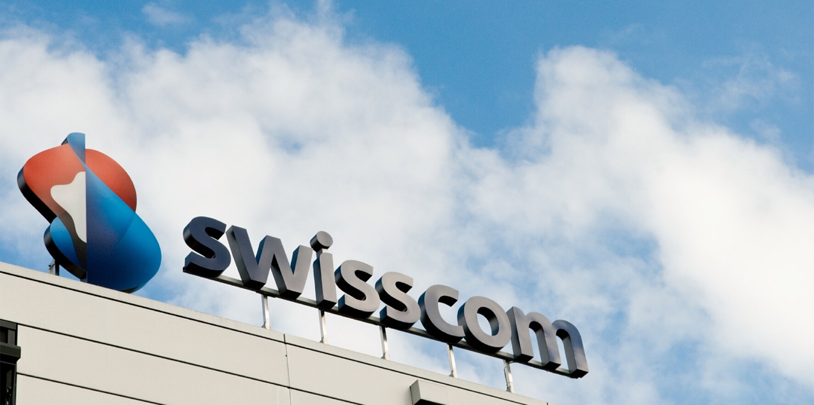
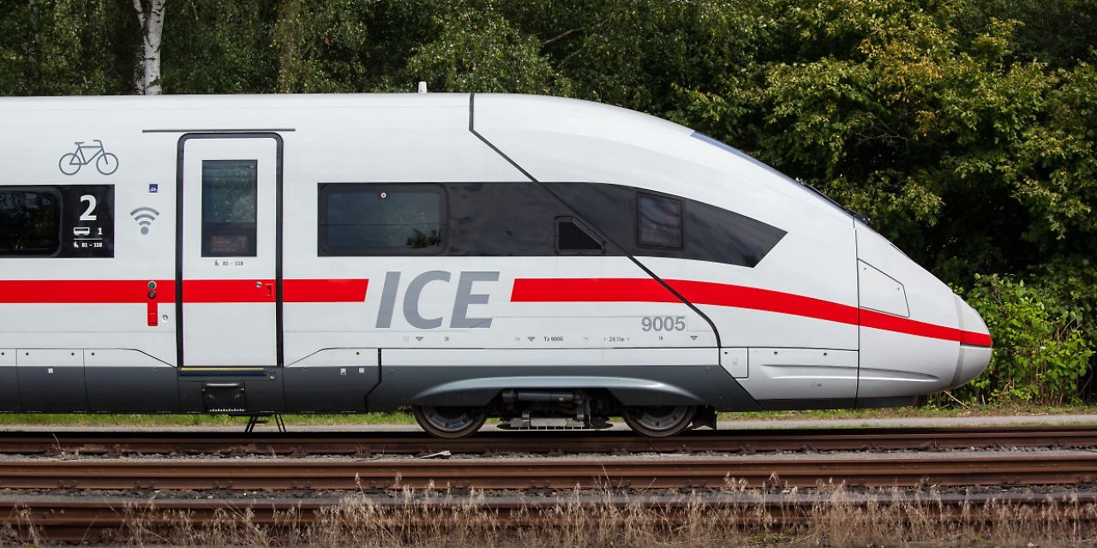
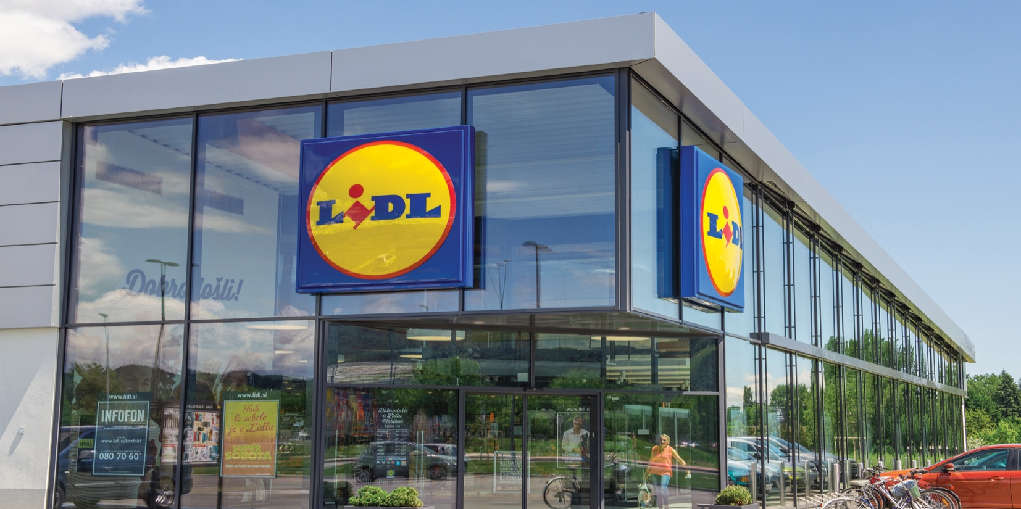
What can we do?

Slide 18
A possible solution: Beyond Leadership
DEBRIEF
Debrief
What have I learned?
CONNECT
Connect
Who am I and why am I here?
Beyond Leadership
Act
What shall I do personally to achieve our common goals?
ACT
Align
Who are we and why are we here?
ALIGN
COMMIT
Commit
Who could we be and what do we aim at?
Notes:
18

